Slide 1

AI Vision Assistant for Visually Impaired Users
COMPUTER VISION ITA0502
PROGRAM DIRECTOR:
Dr. SASI REKHA
PROF/CSE
PRESENTED BY:
SRI HARI N (192572127)
G CHANDRA SEKHAR REDDY(192472173)
P.POORNA CHANDRA (192472287)
MEGHARAJU AKHILKUMAR (192572060)
KATHIKEYAN U (192572131)
FACULTY
Dr . R C . JENI GRACIA
ASS PROF / CSE

Slide 2


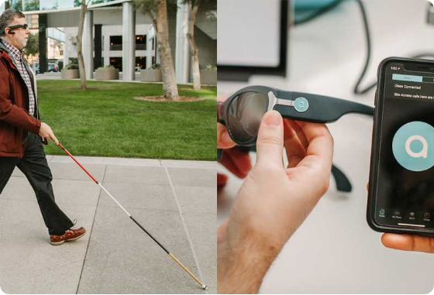
Agenda
Introduction
Literature Review
Problem Statement
System Architecture & Overall Design
Project Modules Overview
Reference
Conclusion

Slide 3
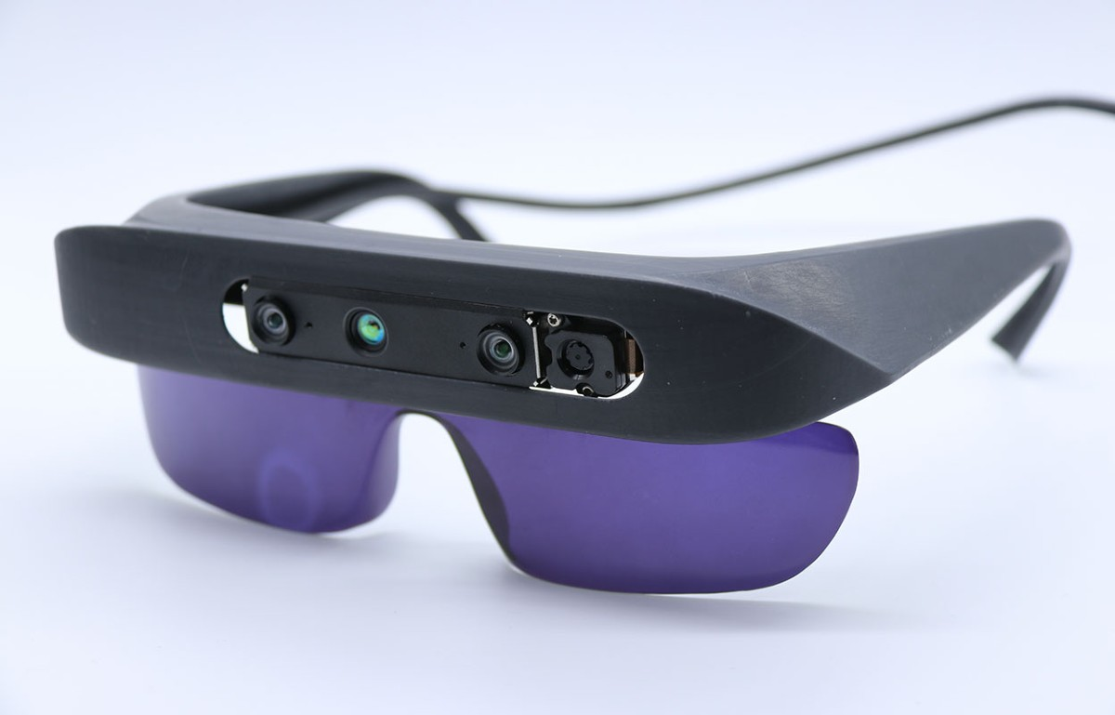
Introduction
Visual impairment creates challenges in navigation and accessing daily information.
Existing assistive tools often perform only one specific task.
This project integrates multiple AI features into a single intelligent assistant.
Uses Computer Vision, OCR, Speech Processing, and AI models.
Provides real-time voice guidance using a smartphone or webcam

Slide 4
Literature Review
S.No | Author(s) | Year | Title | Research Gap
1 | Bin Xiao et al. | 2024 | Florence-2: Advancing a Unified Representation for Vision Tasks | Focused on vision-language understanding but did not integrate obstacle detection, OCR, and navigation into a single assistive system.
2 | Rahima Khanam et al. | 2024 | YOLOv11: An Overview of the Key Architectural Enhancements | Improved real-time object detection but lacked voice guidance and accessibility features for visually impaired users.
3 | Ranjan Sapkota et al. | 2025 | A Comprehensive Review of the YOLO Object Detection Models | Reviewed YOLO advancements but did not propose an integrated AI assistant combining multiple assistive technologies.
4 | Cui et al. | 2026 | PaddleOCR-VL: Boosting Document Parsing Efficiency and Performance | Focused mainly on document OCR and parsing without navigation, object recognition, or scene understanding capabilities.

Slide 5
Problem Statement & Objectives
Visually impaired users rely on multiple applications for different tasks.
Switching between apps reduces efficiency and increases complexity.
Develop an integrated AI-powered vision assistant.
Provide real-time object detection, navigation, OCR, and currency recognition.
Deliver intelligent voice-based interaction for improved independence.

Slide 6
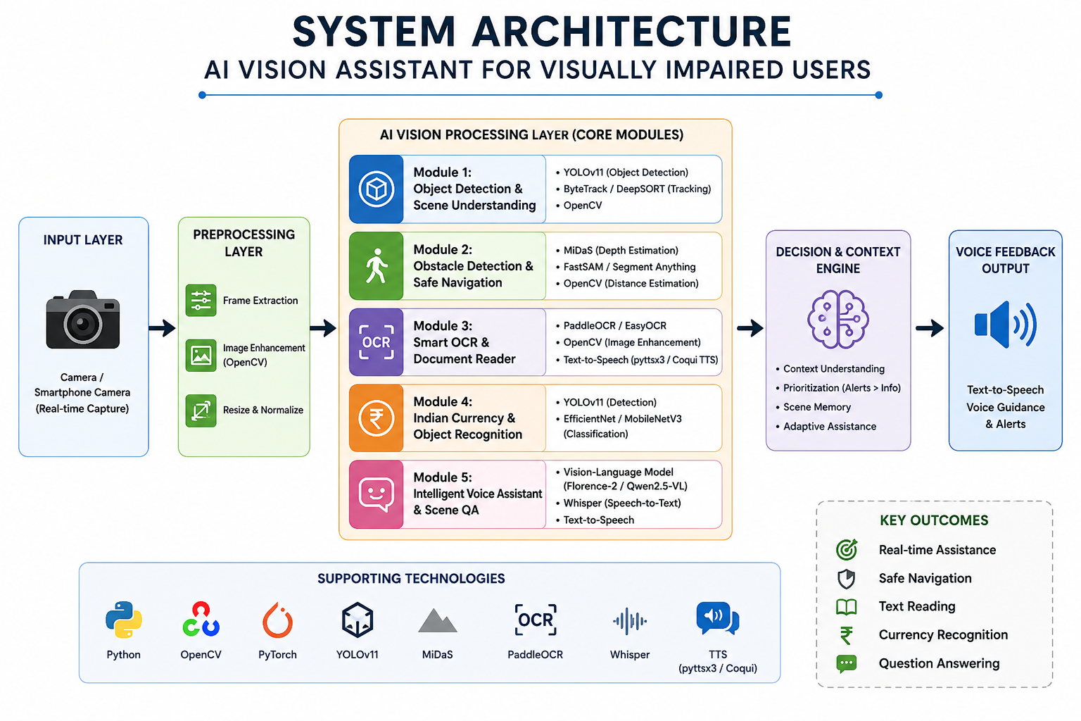

Slide 7
Module 1: Real-Time Object Detection & Scene Understanding
Detects objects around the user using the camera.
Identifies people, vehicles, and everyday objects.
Understands whether the user is indoors or outdoors.
Gives voice messages about what it sees.
Helps the user understand the surroundings.

Slide 8
Module 2: Obstacle Detection & Safe Navigation
Finds obstacles in front of the user.
Measures how close the obstacle is.
Gives voice alerts if an obstacle is nearby.
Helps the user choose a safe path.
Reduces the risk of accidents.

Slide 9
Module 3: Smart OCR & Document Reader
Captures an image of a document.
Reads the text from the image.
Converts the text into speech.
Reads books, bills, and medicine labels.
Helps users access printed information.

Slide 10
Module 4: Indian Currency & Essential Object Recognition
Detects Indian currency notes and coins.
Recognizes important daily-use objects.
Announces the detected item by voice.
Helps users during shopping.
Makes daily tasks easier.

Slide 11
References
Bhavesh Kumar. (2021). ViT Cane: Visual Assistant for the Visually Impaired. arXiv. Available at: https://arxiv.org/abs/2109.13857
Real-Time Obstacle Detection and Audio Navigation for the Visually Impaired Using YOLO," in 2025 5th International Conference on Emerging Research in Electronics, Computer Science and Technology (ICERECT), IEEE, 2025. doi: 10.1109/ICERECT65215.2025.11376185.
[9] "Smart Wearable for Real-Time Object Detection and Assistive Navigation," in 2025 9th International Conference on Computational System and Information Technology for Sustainable Solutions (CSITSS), IEEE, 2025. doi: 10.1109/CSITSS67709.2025.11295712.
An Effective Obstacle Detection System Using Deep Learning Advantages to Aid Blind and Visually Impaired Navigation. (2024). Ain Shams Engineering Journal, 15(2), 102387.
Luis Marquez-Carpintero et al. (2025). An Artificial Intelligence-based Assistant for the Visually Impaired (AIDEN). arXiv.

Slide 12
Conclusion
Developed an AI-powered vision assistant that integrates multiple assistive technologies into a single platform.
Enables real-time object detection, obstacle avoidance, OCR, currency recognition, and scene understanding.
Provides voice-based guidance and natural interaction, improving accessibility and user independence.
Utilizes advanced AI models such as YOLOv11, MiDaS, PaddleOCR, Whisper, and Florence-2/Qwen2.5-VL for accurate and efficient performance.
Aims to enhance the safety, confidence, and quality of life of visually impaired users through intelligent, real-time assistance.

Slide 13


